Slide 1
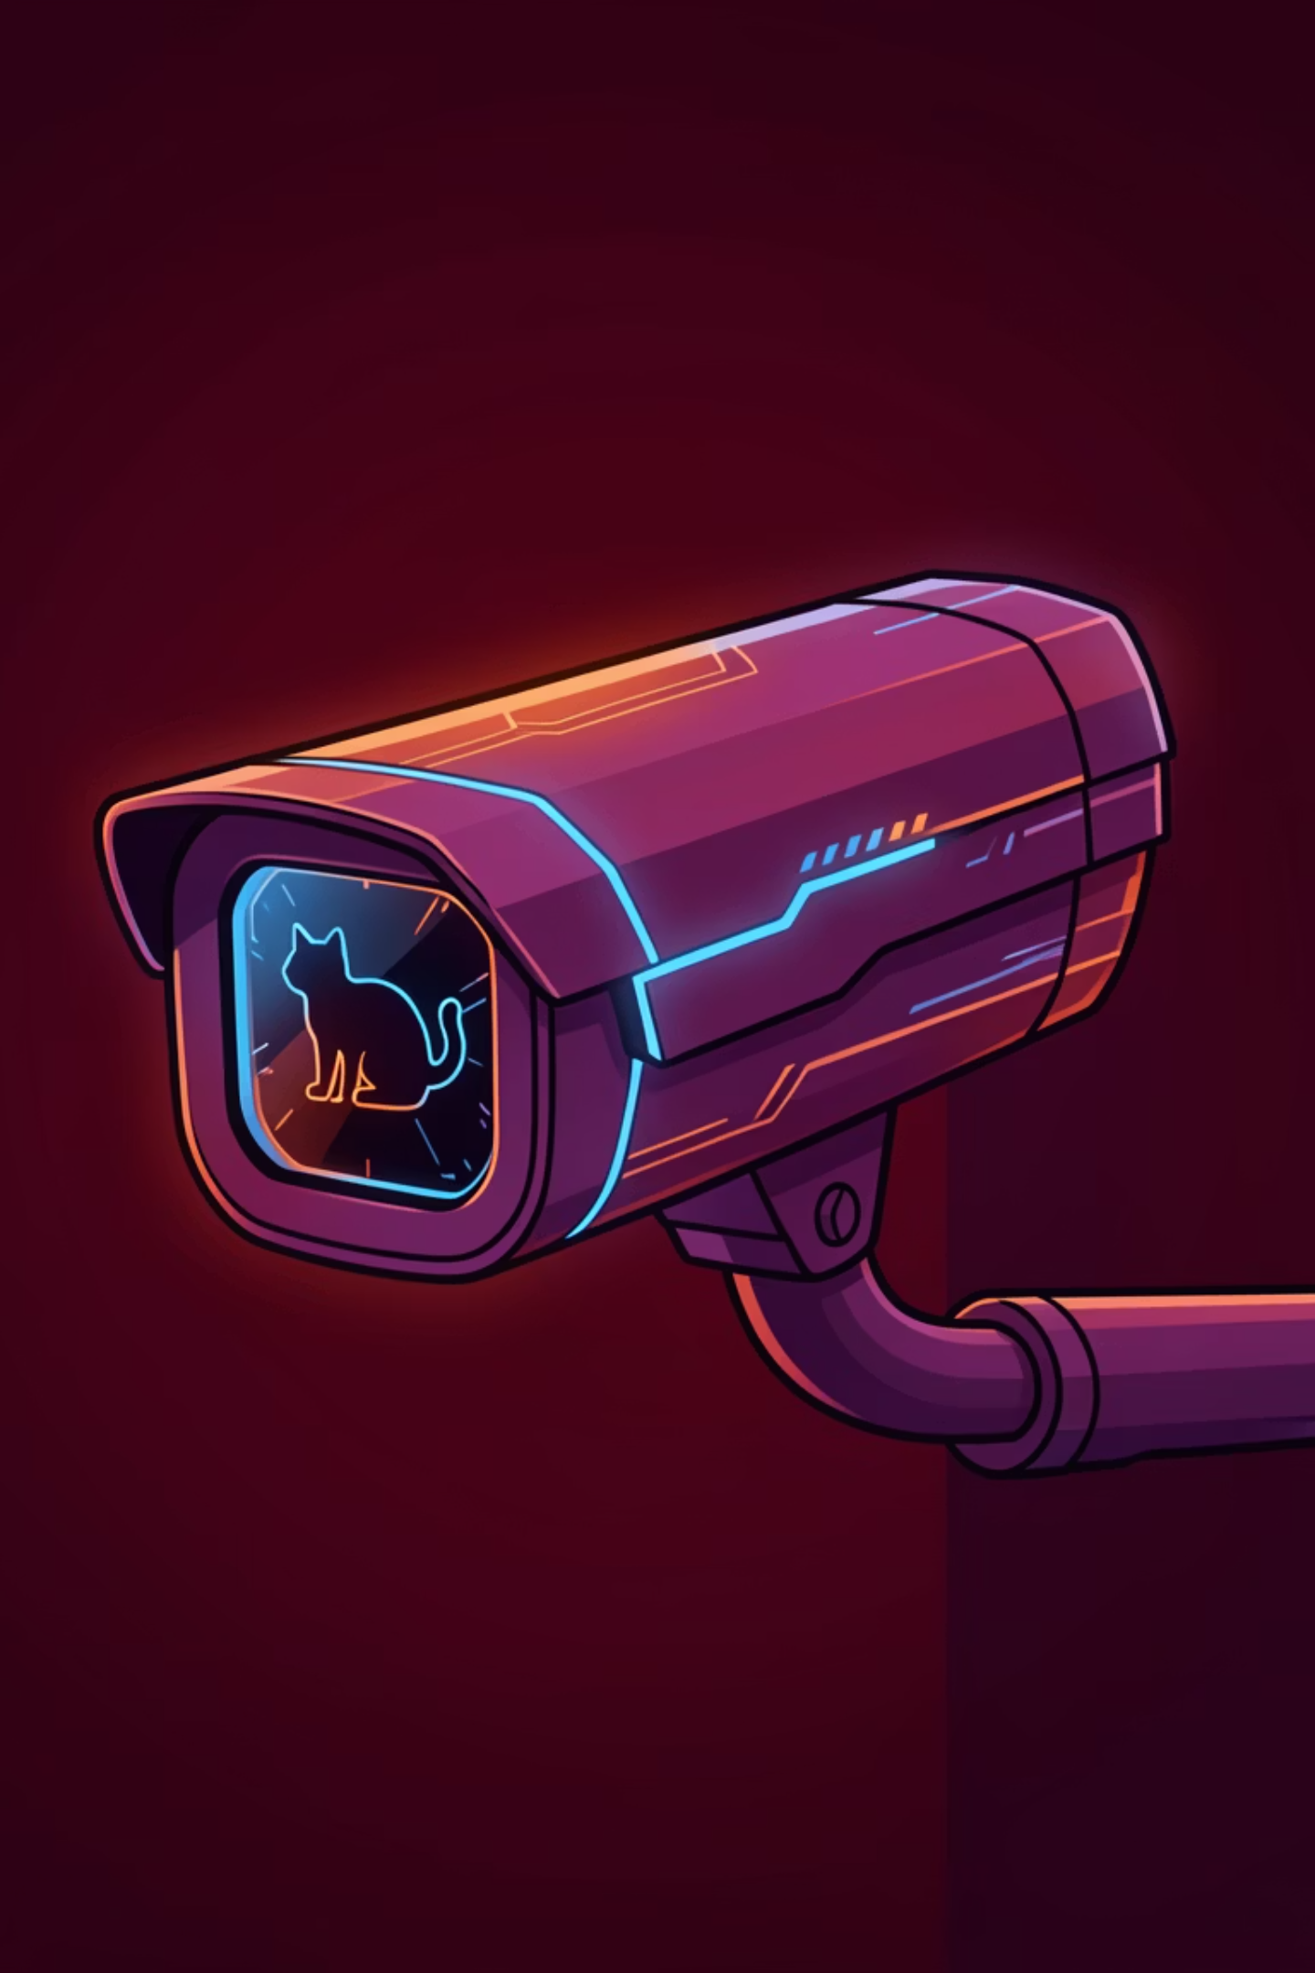
Cat Motion Detector
Intelligent Motion Detection & Object Recognition System
Team Cat Project • January 2026

Slide 2
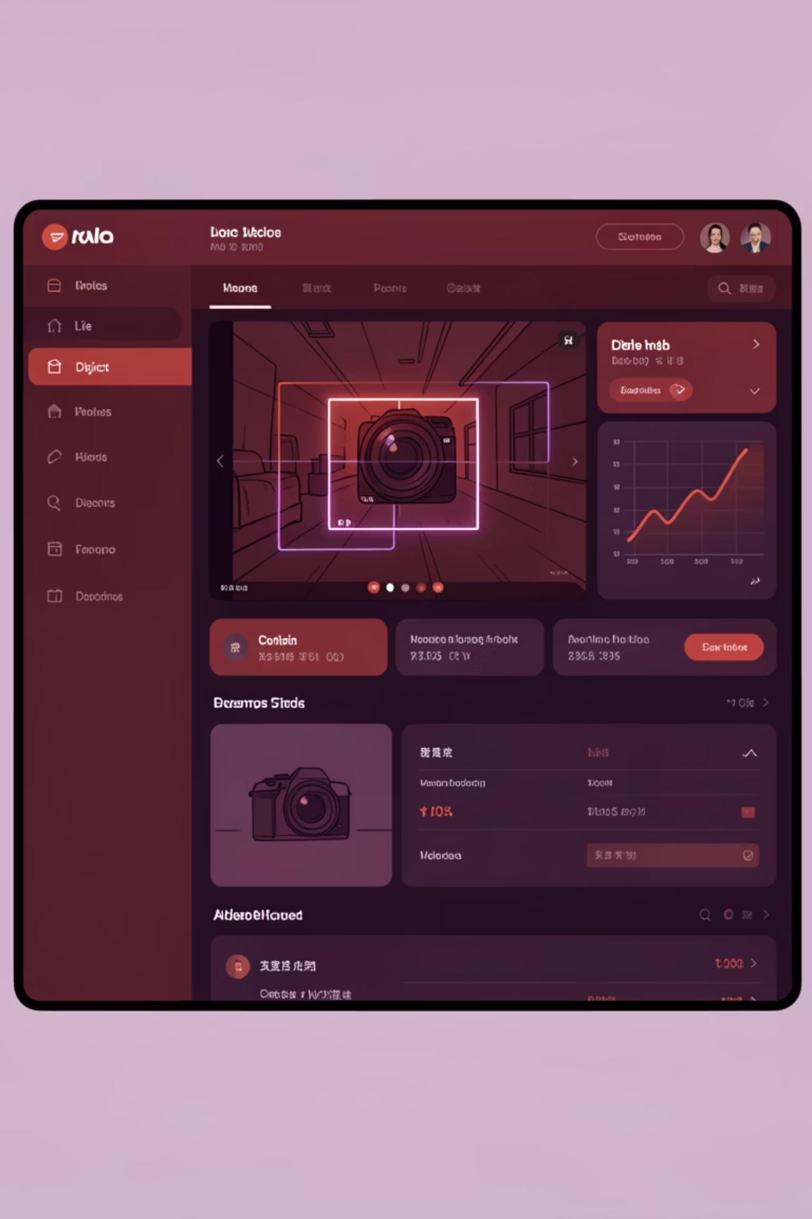

PROJECT OVERVIEW
What is Cat Motion Detector?
A real-time motion detection and object recognition system combining computer vision and deep learning for intelligent monitoring.
Detects Motion
Computer vision algorithms track movement in real-time
Identifies Objects
YOLO deep learning recognizes cats, dogs, and people
Sends Notifications
Instant alerts via Discord
Web Interface
Live monitoring dashboard with detection storage

Slide 3

COMPONENT
Frame Producer
Purpose
Implementation
Captures video frames from camera source and provides them to consumers with minimal latency.
class FrameProducer:
- start()
- stop()
- get_frame()
- _capture_loop()
Key Features
📹 Threaded capture - Non-blocking frame acquisition
🔄 Continuous operation - Always provides latest frame
💾 Frame buffering - Stores most recent frame
⚡ High performance - Minimal latency
Responsibilities: Manage camera connection, capture frames in background thread, provide latest frame on demand, handle errors gracefully.

Slide 4
COMPONENT
Motion Detector
Analyzes frames to detect motion using background subtraction and contour analysis.
01
02
Convert to Grayscale
Apply Gaussian Blur
Simplify frame for processing
Reduce noise and smooth image
03
04
Calculate Difference
Threshold to Binary
Compare frame to average background
Create black and white motion mask
05
06
Find Contours
Yield Motion Event
Identify moving objects above minimum area
Trigger alert if criteria met

Slide 5




AI COMPONENT
Image Analyzer (YOLO)
Identifies specific objects using YOLO v3 deep learning model for real-time detection.
Input Image
YOLO Network
416×416 preprocessing
80 object classes
Detection Results
Filter Targets
Boxes + labels + confidence
Cat, dog, person
Key Features
🧠 YOLO v3 model for real-time detection
🎯 Multi-object detection capability
📦 Bounding boxes with visual annotation
🔢 Confidence scoring for reliability
🎨 NMS removes duplicate detections

Slide 6
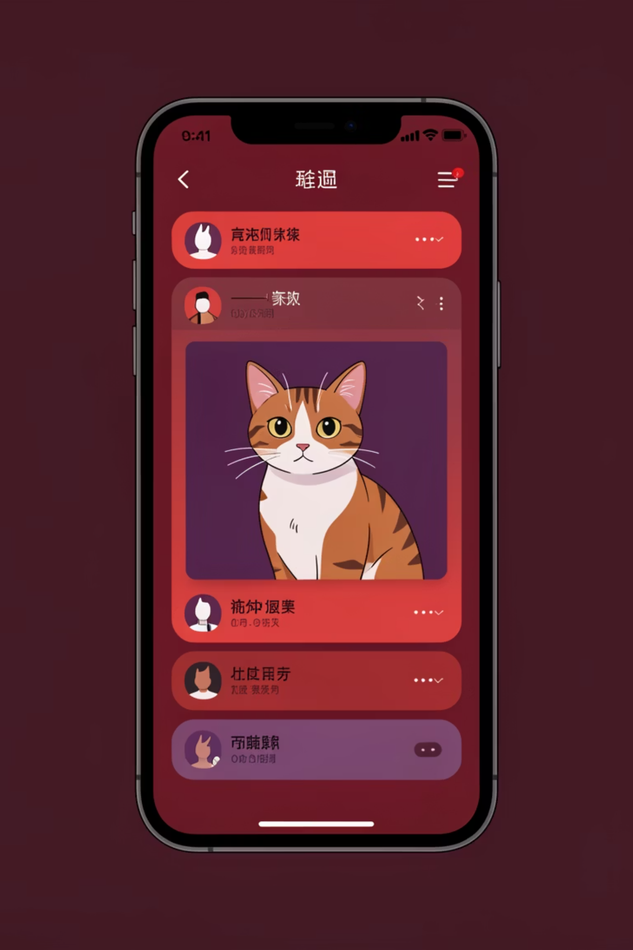
COMPONENT
Notification Services
1
Detection
Object identified
2
Save Image
Store annotated frame
3
Discord Bot
Instant mobile alert
Discord Notifier
📱 Instant real-time alerts
🖼️ Image attachments for visual confirmation
💬 Custom captions with detection details
🔐 Secure bot token authentication

Slide 7
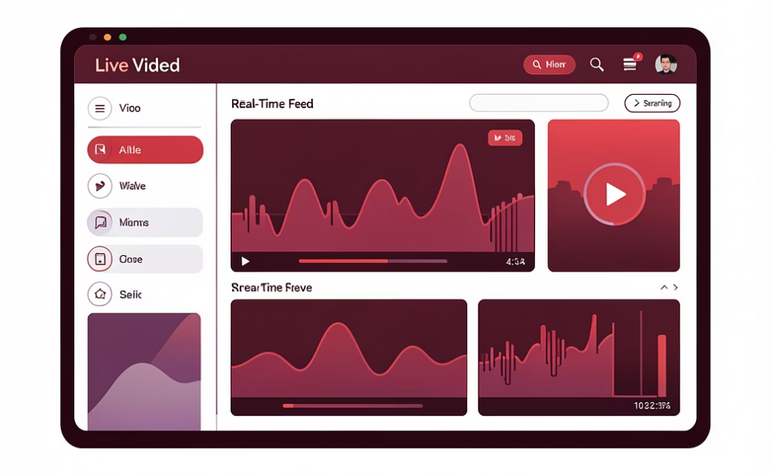
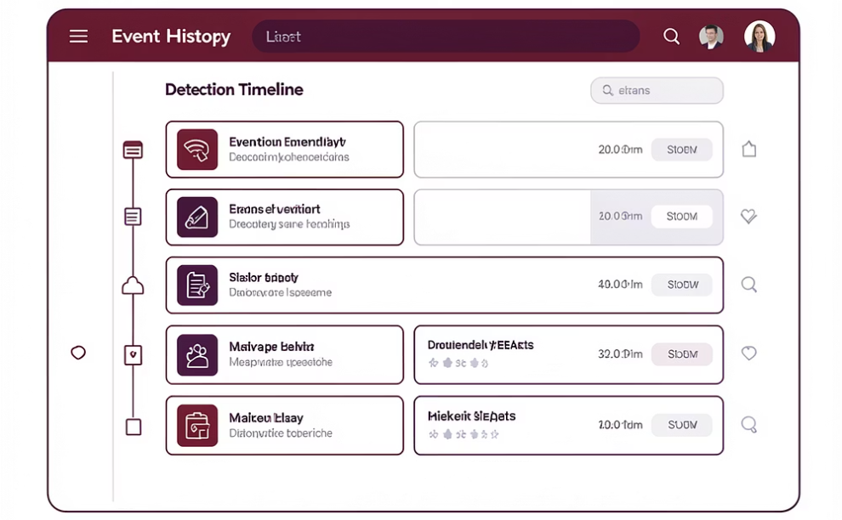
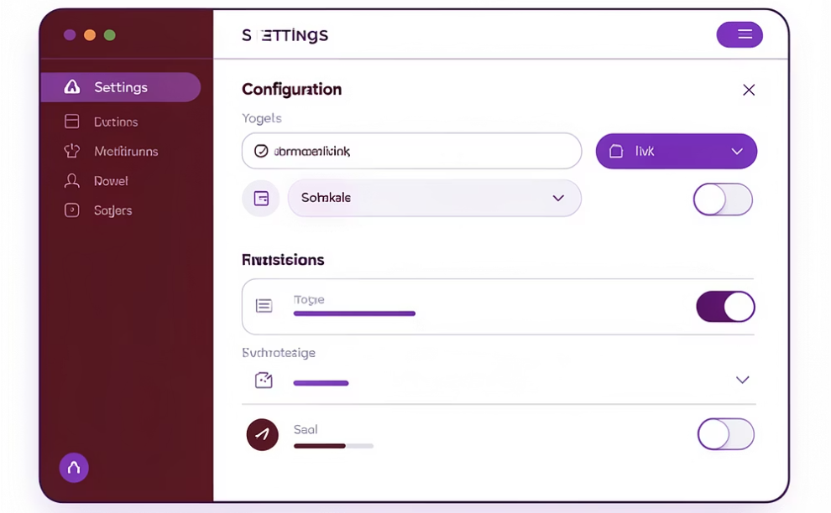
COMPONENT
Web Dashboard
Real-time web interface for monitoring and configuration with responsive mobile-friendly design.
Live Video Feed
Event History
Settings Panel
Real-time camera stream with WebSocket updates
Recent detections list with timestamps
Configure detection parameters and thresholds
Technology Stack
Backend: Flask + Flask-SocketIO
Frontend: HTML5, CSS3, JavaScript
Real-time: WebSocket communication
Streaming: MJPEG video feed

Slide 8
Interesting Facts
30
50ms
<100ms
80
FPS Processing
YOLO Inference
WebSocket Latency
Object Classes
Real-time video processing speed
Per frame detection time
Real-time communication speed
Different detectable objects (COCO dataset)
100
24/7
Detection Images
Operation
Stored with auto-cleanup
Continuous monitoring capability
🔧 Technologies
OpenCV for computer vision • YOLO v3 for deep learning • Flask web framework • WebSocket real-time communication • Python threading for concurrent operations

Slide 9
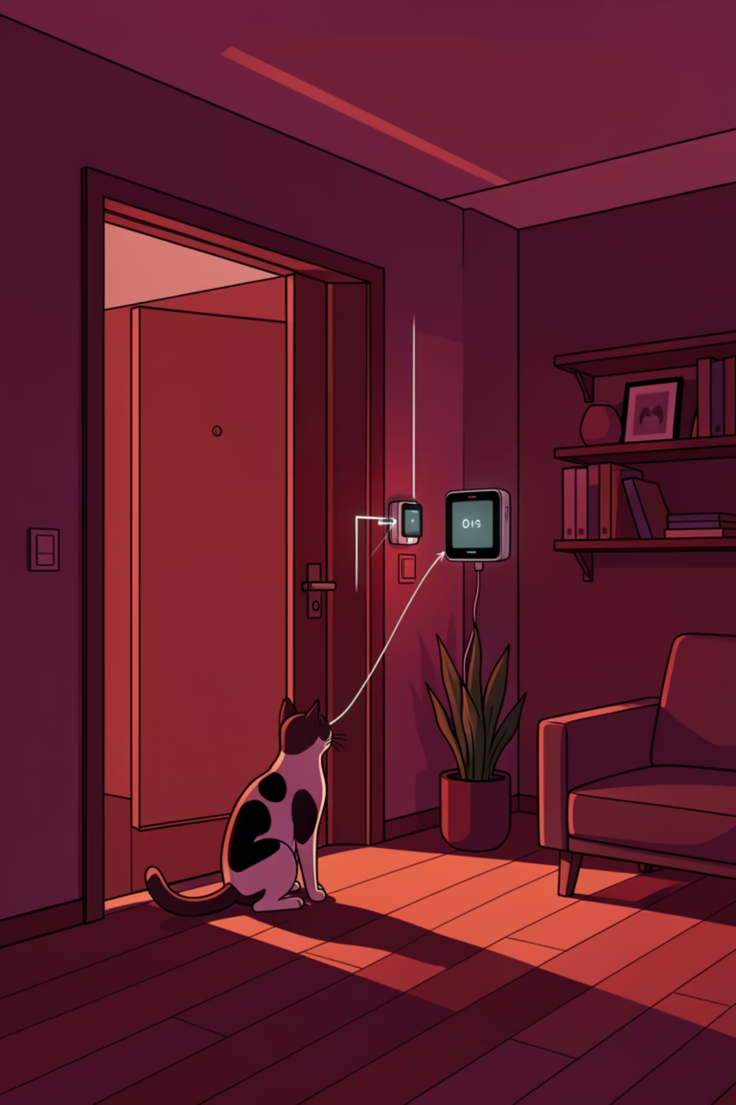
Use Cases
Home Security
Monitor for intruders with people detection, detect pets in restricted areas, and record activity when away from home.
Pet Monitoring
Track when cats enter/exit through pet door, monitor pet activity patterns, and receive alerts for specific areas.
Smart Notifications
Receive instant alerts on phone via Telegram, get email summaries with images, and review detections via web dashboard.
Video Analytics
Count daily detections, analyze movement patterns over time, and store evidence of important events.

Slide 10

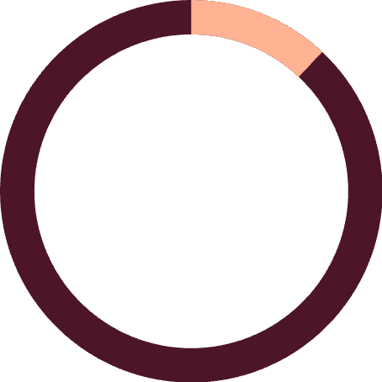
Project Statistics & Conclusion
2,500
12
Lines of Code
Main Components
Python implementation
Modular architecture
The Cat Motion Detector is a production-ready system combining traditional computer vision, modern deep learning, real-time communication, multi-channel notifications, and a user-friendly web interface.
Real-time processing at 30 FPS
Accurate object detection with YOLO
Reliable notification system
Scalable architecture
Comprehensive documentation
Thank You!
Questions?

